Slide 1
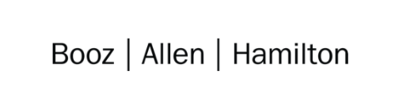

Cloud Excellence Presentation Team 1
Members: Anjelique Butler Chris Mickey Harwinder Singh Kate Briggs Sarah Grimm
August 2021

Slide 2
Web Application
TEAM 1:
Our Official Project for the Booze Allen Cloud Excellence Program
www.webagesolutions.com|1.877.517.6540

Slide 3





INTRODUCTIONS
CHRIS MICKEY
Staff Technologist
ANJELIQUE BUTLER
Staff Technologist
SARAH GRIMM
Technologist
HARWINDER SINGH
Lead Technologist
KATE BRIGGS
Technologist

Slide 4
Project
Introductions
Project Overview
Architecture/Design diagram
Tools/Software Environment used
Challenges/Issues/Problems/Your stories
What have you learned/learned?
What else can we do on the project? - future plan- any design and implementation ideas?
Demo
Questions and answers
International Pet Players
Web Application
www.webagesolutions.com|1.877.517.6540

Slide 5
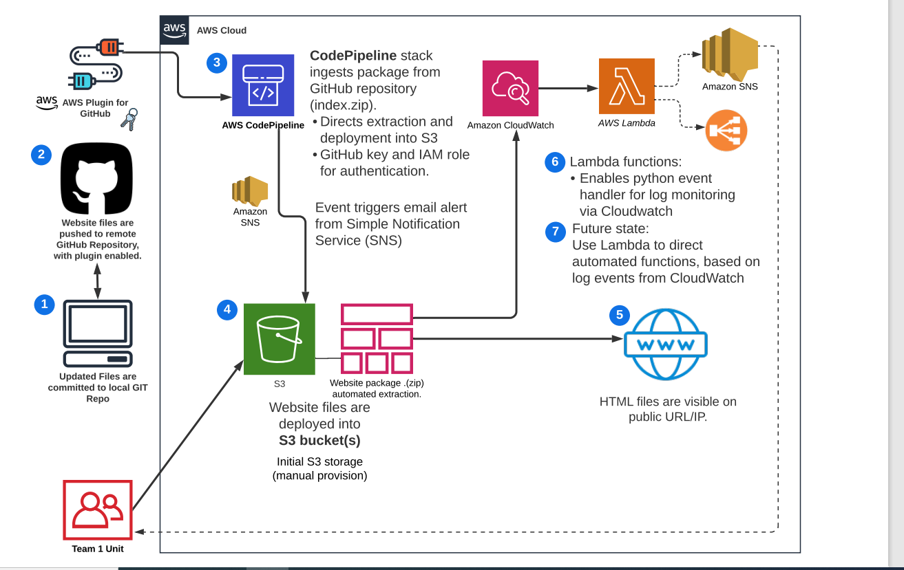
Architecture and Design

Slide 6

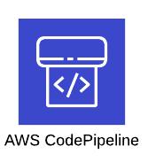

Technologies and Environment used
FEATURE | DESCRIPTION
AWS IAM | AWS identity and access management (IAM) tool for users, groups, roles and access
AWS S3 | AWS cloud storage feature, Serverless Storage Service (S3).
AWS CodePipeline | Service used to automate code deployments
AWS SNS | Simple Notification Service for enabling event-driven alerts
AWS Lambda | Serverless web service that can execute functions in python, Javascript, etc. (prebuilt or custom)
AWS CloudWatch | AWS event monitor used to view logs for infrastructure and account activity
Git with GitHub | Repository for website code and related files.
GitHub
Notes:
IAM – Used to add our personal user accounts, security groups, roles and policies.
S3 –Serverless storage that we used to host our static webpage based on reasons Anjelique mentioned
CodePipeline – Used to automate code deployments and we chose to use this opposed to Jenkins, to simplify our process as it is already within AWS, and we did not have a complicated build sequence.
SNS – Our notification is based on an S3 event and sends an email to those subscribed, to inform anytime there is an update to the bucket
Lambda – We included this feature for future state so that automated management of infrastructure resources can be added when ready
CloudWatch – used to view logfiles and account activity
GitHub – Repository/Version control tool of choice where our project artifacts are stored

Slide 7
Issues and Challenges
Issues
How to be realistic about security early in the development process
Overwhelming number of services to choose from and the different options for infrastructure
Challenges
Getting everyone set up with Git properly, some using desktop app and others CLI
Received error when trying to add SNS notification and had to troubleshoot permissions between services
Researched how to reduce number of notifications received when pipeline runs
The sensitivity of the configuration sequence and how timeouts can result in lost work

Slide 8
Lessons Learned
Take aways…
When adding users, download csv right away with credentials because otherwise if screen times out, you lose session and information is gone.
S3 bucket must be in same region as pipeline when using CodePipeline
We could not see pipeline after initial execution. We realized in a different region when pipeline created and that we all need to make sure we are in the same region!
Creating SNS topic before S3 bucket simplifies notification process
Filter your S3 notifications!

Slide 9
Demo

Slide 10
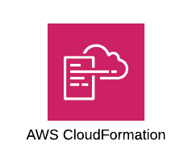

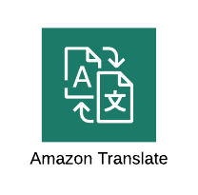



Future State - What we would add
Run Test Script
Create Temporary Resources
Run Test on Temporary Stack
Pipeline for Testing Website
Create automated test script (potentially in Cloud Formation) that would deploy an S3 bucket on demand, to test website functionality
User-driven features
Implement automated web services that generate output on webpage in response to user data
E.g., webpage language could be updated based on user location
SNS notification for infrastructure monitoring
Automated alerts based on resource utilization or cost, etc.
Enhanced user experience
User Alerts
App Alerts
Network Alerts

Slide 11
Q & A - Ask us anything

Slide 12
Thank you!!!
August 2021

